Slide 1
STUDENT RECORDS MANAGEMENT
-BY
ANNALAKSHMI A
ABINAYASHREE SV
AISHWARYA G

Slide 2
INTRODUCTION
Efficient management of student records is critical for educational institutions to uphold accurate academic records and streamline administrative processes effectively. Traditional paper-based systems are inherently prone to errors, data redundancy, and vulnerabilities in terms of security, necessitating a transition towards more reliable digital solutions.
The SRMS aims to centralize student information, thereby consolidating data from various sources into a unified repository. This consolidation enhances data integrity by minimizing inconsistencies and improving accuracy in record- keeping.

Slide 3
TECHNOLOGY STACK
Database Management System (DBMS):
MySQL: Chosen for its reliability, scalability, and compatibility.
Backend:
Java: Provides robustness and scalability.
Spring Boot: Framework for rapid application development and integration.
Frontend:
JavaScript: Builds a responsive and user-friendly interface.
Security:
Spring Security: Implements role-based access control (RBAC) and ensures data security.
Integration:
Hibernate: Object-relational mapping (ORM) for database interaction.
Deployment:
Apache Tomcat: Web server for hosting the application.

Slide 4
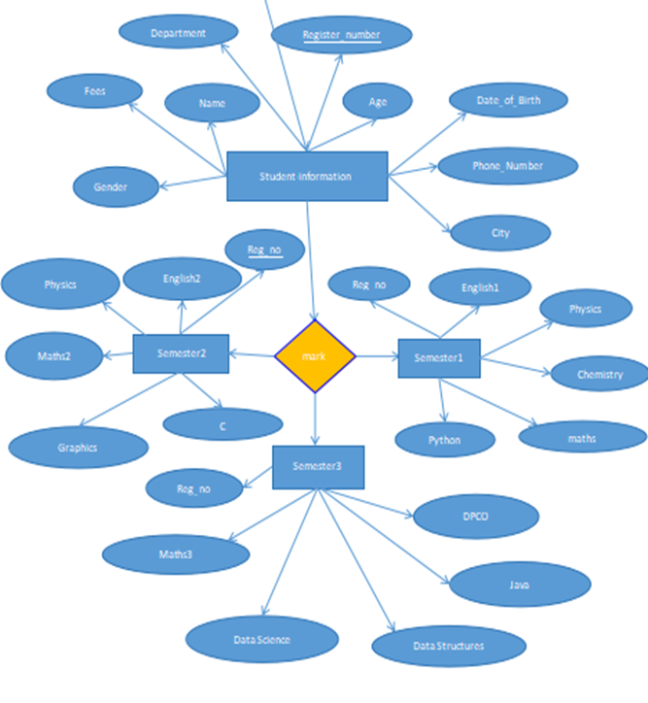
ER DIAGRAM

Slide 5
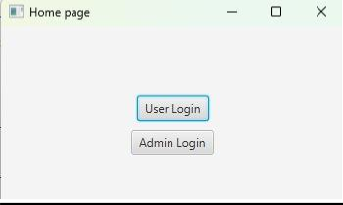
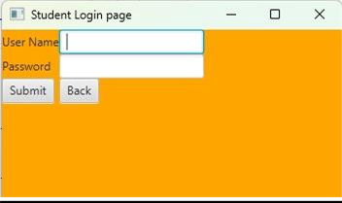
OUTPUT
HOME PAGE
STUDENT LOGIN PAGE

Slide 6
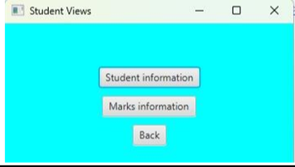
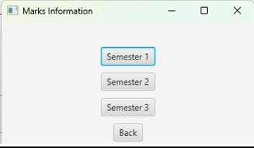
STUDENT VIEW
MARKS PAGE

Slide 7
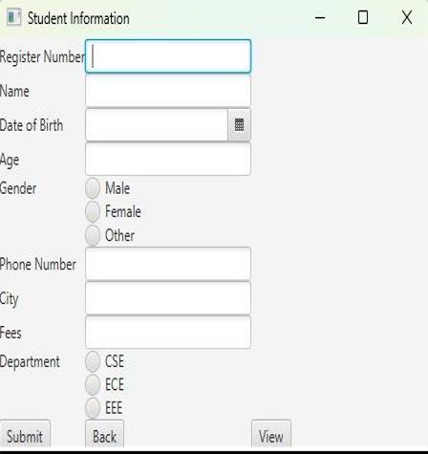
STUDENT INFROMATION PAGE

Slide 8
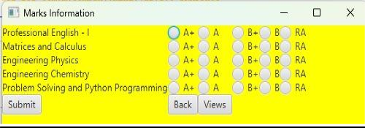
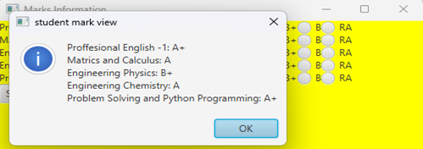
MARKS INFORMATION
STUDENT MARK VIEW

Slide 9
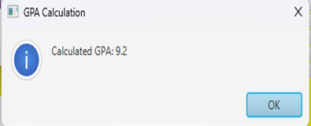
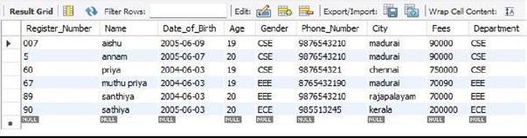
GPA CALCULATION
INFORMATION IN DB

